Slide 1
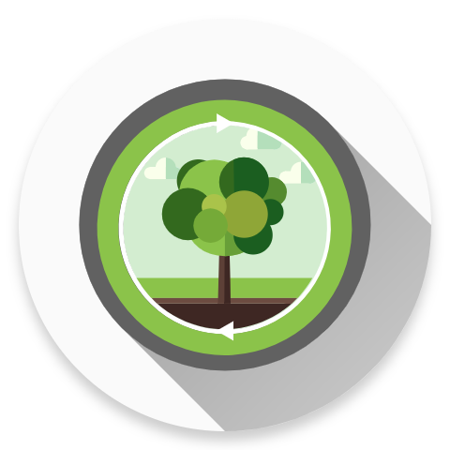
U.Plan()
Wang Yiqin
Alistair Cheong
Chen Zerui
Notes:
Good morning judges we are group u.plan(). I am yiqin he is alistair and he is zerui.

Slide 2
Research
Notes:
Let’s first start by introducing the purpose of U.Plan().

Slide 3
Respondents saw insufficient academic skills as closely related to lack of time management skills, often mentioning the two in the same sentence.
As a separate subcategory, poor time management and organisational skills ranked second as a major roadblock to student success.
Cherif, Adams, Movahedzadeh, Martyn and Dunning. (2014). Why do Students Fail? Faculty’s Perspective. [On-Line]. Available: http://cop.hlcommission.org/Learning-Environments/cherif.html. Retrieved 6 March 2017.
Notes:
We noticed a problem among students nowadays. In 2011 researchers conducted a survey on college students, asking them why students underperform in academics. Respondents said poor time management translated into bad academics, and time management ranked second in hindering student success. These show that poor time management is bad for students’ work life, and Something needs to be done to improve it.

Slide 4



SMART
To Do List
IMPROVE
Time Management
BETTER
Work Life
Notes:
Hence we created U.Plan(), A smart to do list Android app aimed at improving time management skills of students so that they can live a better work life.

Slide 5
Features
Notes:
Now we shall elaborate on U.Plan() features.

Slide 6
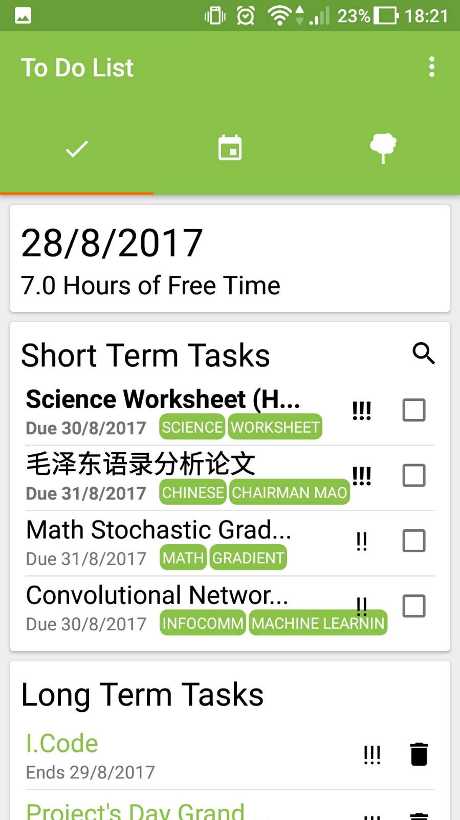

SMART
To Do List
Notes:
Firstly U.Plan() has a smart to do list that lets users organize their tasks into Short Term and Long Term. Short Term tasks are one-off assignments due within a few days, while Long Term Tasks are carried out over a period of time like project work. We believe this classification of tasks can help students better organize their work life.

Slide 7

PRIORITY
Notes:
For short term tasks you can set a priority as denoted by number of exclamation marks.

Slide 8

TAGGING
Notes:
, tag tasks according to subject,

Slide 9

NOTIFICATIONS
Notes:
And receive automated notifications.

Slide 10
Notes:
Long term tasks have the same constituents, minus the tags.

Slide 11
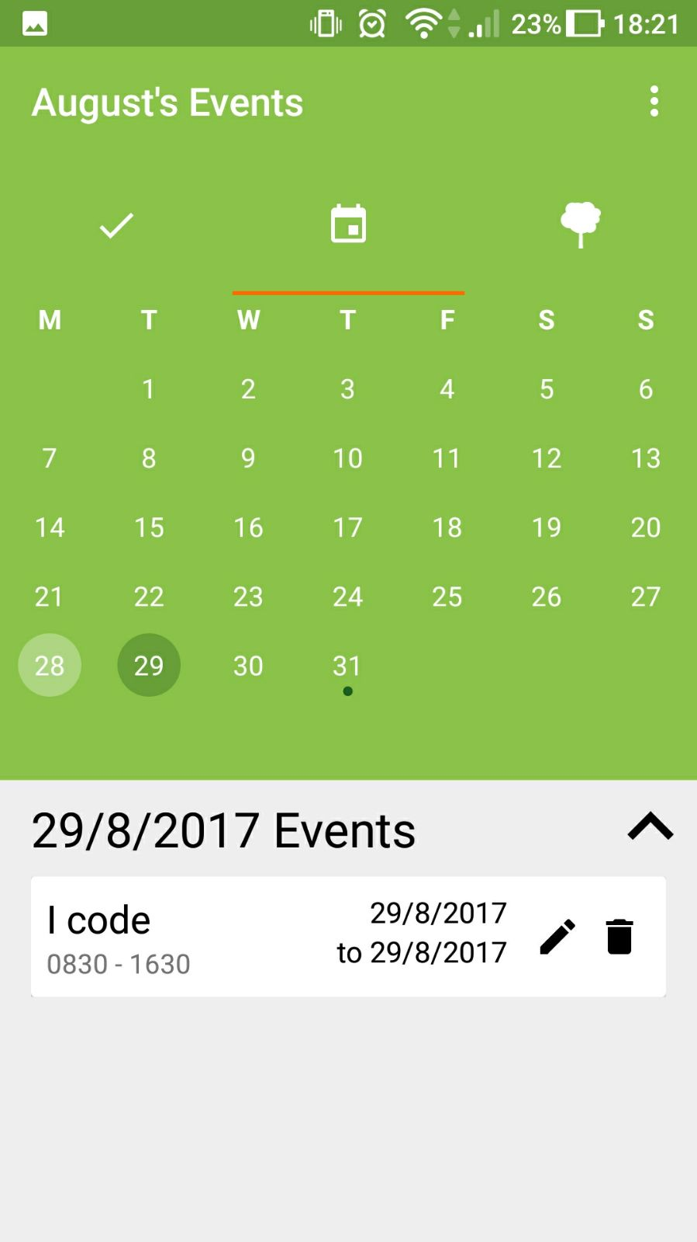

EVENT
Calendar
Notes:
U.Plan() also has a built-in events calendar which display each day’s events clearly in a clean and easily accessible manner.

Slide 12

DATE RANGE
Notes:
In here, you can add events with customizable date and time ranges.

Slide 13

FREE TIME
Notes:
We know that students have lots of commitments so we estimate their free time to be 7 hours on weekday and 12 hours on weekend, and subtract the free time whenever they have an event. So this gives them a guideline of work length everyday.

Slide 14

TREE
Because we all love green
Notes:
With the threat of global warming approaching, we hope to send a message of environmental protection. So we added the user tree.

Slide 15




SEED
SHOOT
SAPLING
TREE
Notes:
Designed to incentivise students to complete tasks and inculcate values of discipline and patience, The Tree has a growth attribute that determines its stage and a Water attribute that determines its hydration. Therefore, the user will gain a sense of accomplishment as they witness the growth of their tree as they complete tasks.

Slide 16
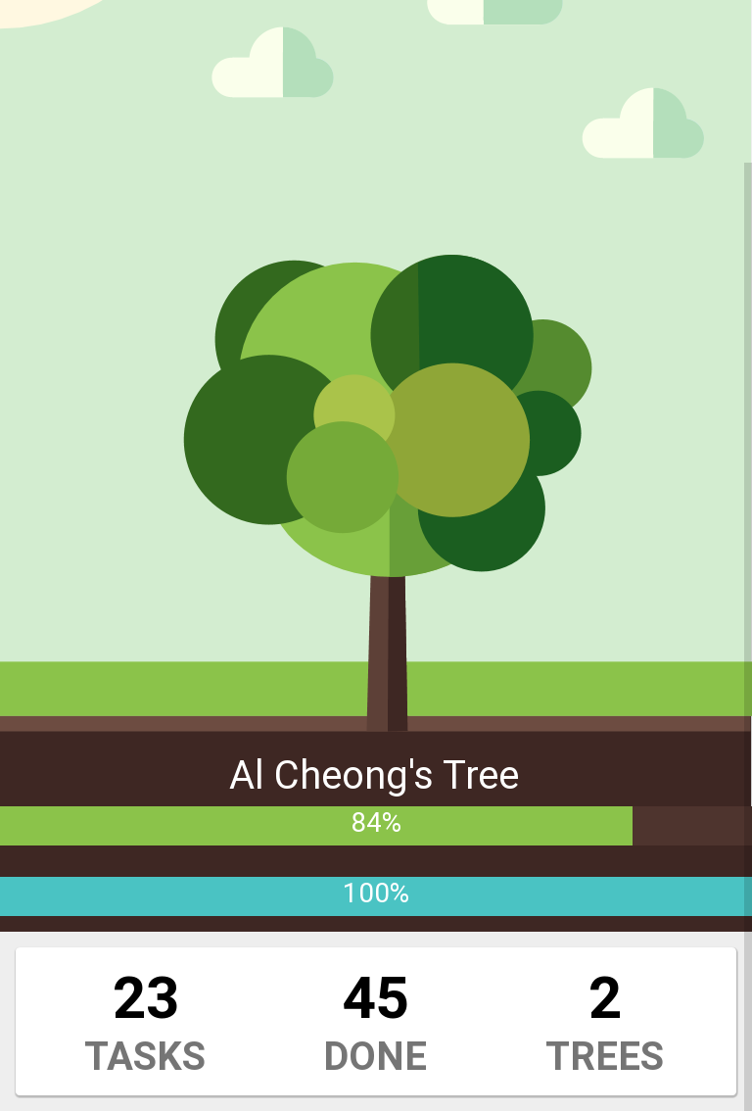
Growth
Hydration
Notes:
Users must complete tasks to keep their tree alive or else it will dehydrate.

Slide 17

MORNING
Reviews
Notes:
Lastly, U.Plan() will give users morning reviews on first startup.

Slide 18
TASKS
Overview
EVENTS
Overview
TREE
Analysis
Notes:
The morning review consists of an intro, an overview on the 4 most important tasks, an overview on today’s events, and an analysis of the tree.

Slide 19
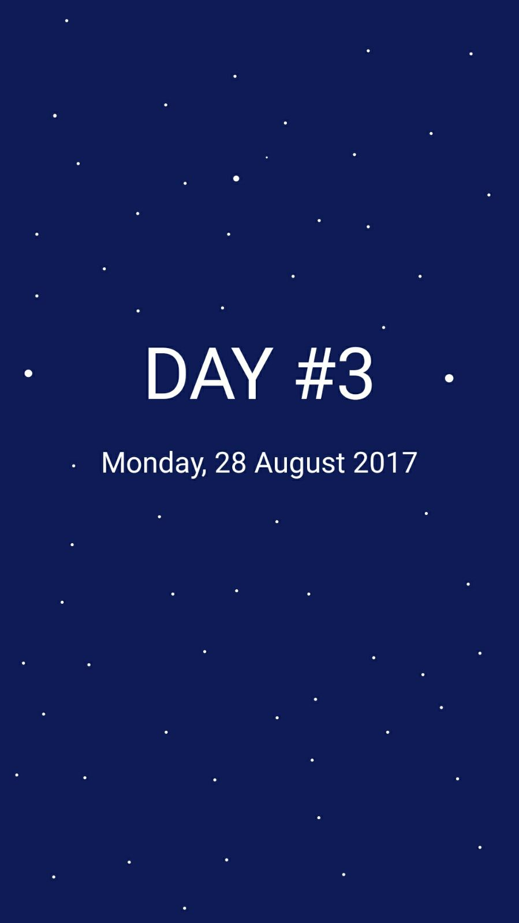
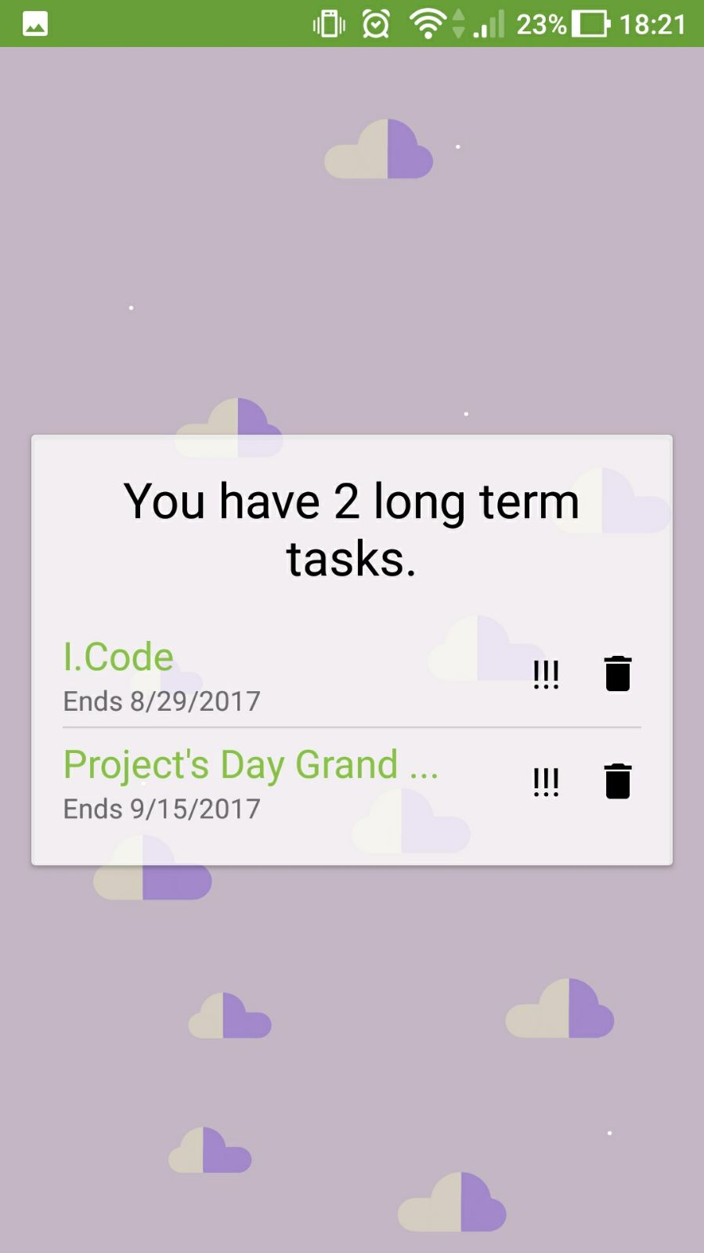
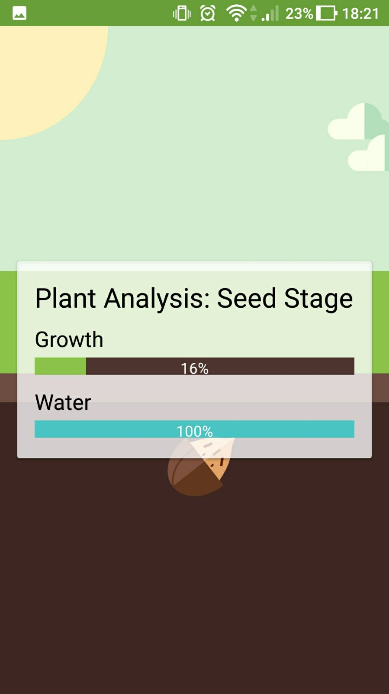
Notes:
The review lets users keep their plan for the day concrete. If users need an overview of their tasks, they can replay the morning review anytime during the day.

Slide 20
Live Demo
Notes:
And now for a live demo of U.Plan() features.

Slide 21
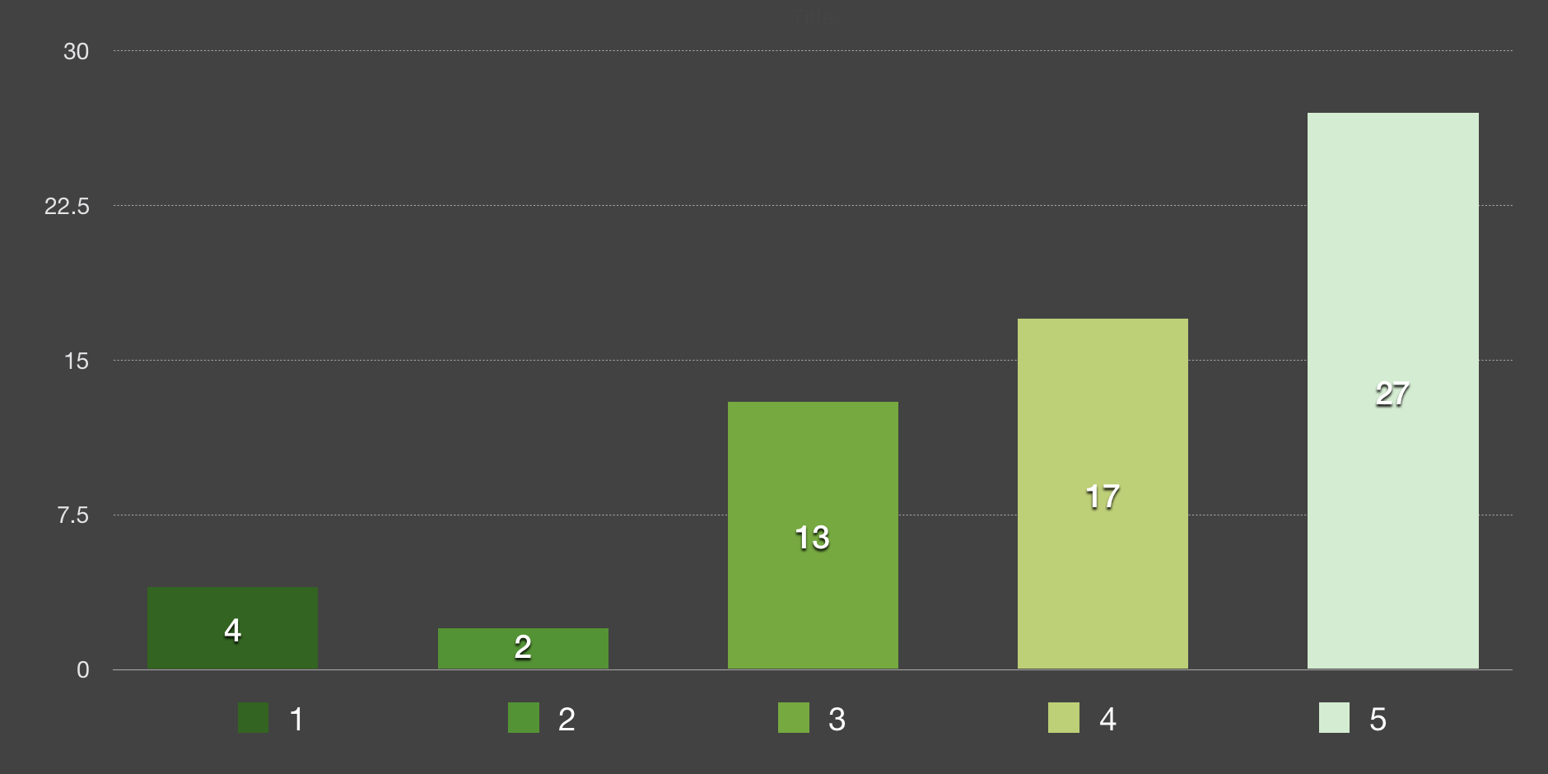
Was knowing how much free time you have useful?
Notes:
We conducted a survey on 62 students to find out how much U.Plan() was needed. 27 of them found that knowing how much free time they had was very useful,

Slide 22
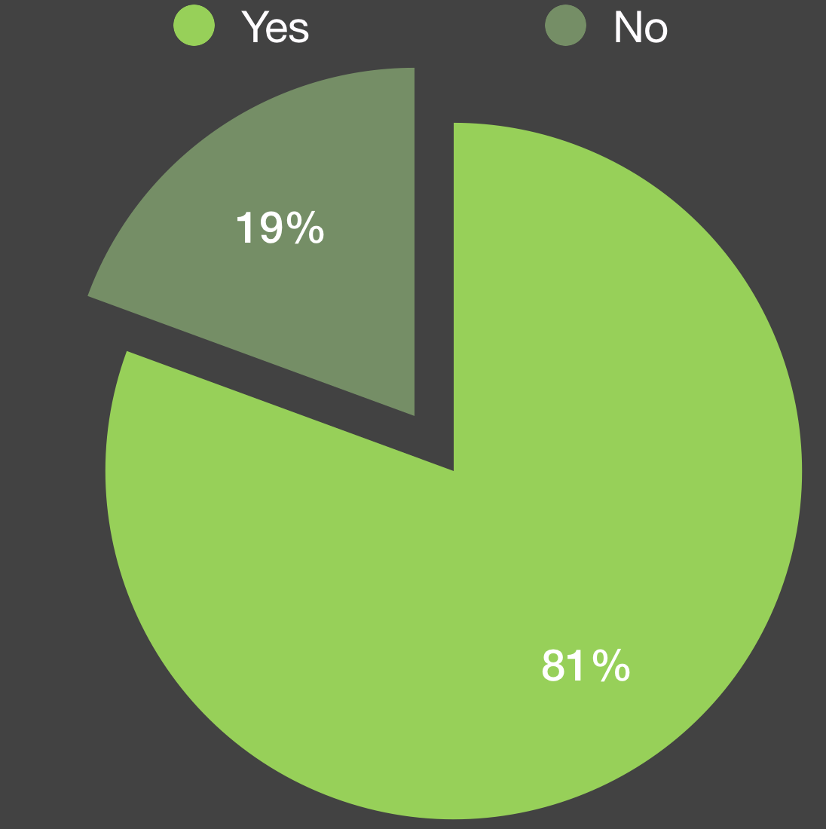
Did you like morning reviews to jog your memory?
Notes:
and 80% of them liked our morning reviews that jogged their memory. These show the usefulness and practicality of U.Plan().

Slide 23

Methodology
Android Studio
Notes:
We would like to give credit to android studio, the official IDE for android app development by google.

Slide 24
Bibliography
GitHub. (2017, April 17). AigeStudio/WheelPicker. Retrieved August 16, 2017, from https://github.com/AigeStudio/WheelPicker.
GitHub. (2017, July 26). SundeepK/CompactCalendarView. Retrieved August 16, 2017, from https://github.com/SundeepK/CompactCalendarView.
GitHub. (2017, June 15). Deano2390/MaterialShowcaseView. Retrieved August 16, 2017, from https://github.com/deano2390/MaterialShowcaseView.
List. Modified from https://icons8.com/web-app/4023/todo-list.
Event. Retrieved from https://material.io/icons/.
Dashboard. Retrieved from https://raw.githubusercontent.com/google/material-design-icons/master/action/2x_web/ic_dashboard_white_48dp.png.
Search. Modified from https://en.wikipedia.org/wiki/File:Vector_search_icon.svg.
Tree. Modified from https://www.shareicon.net/tag/tree?s=glyph.
Calvin Yang. (2016). Tried-and-tested ways to prepare for year-end exams. [On-Line]. Available: http://www.straitstimes.com/singapore/education/tried-and-tested-ways-to-prepare-for-year-end-exams. Retrieved 20 February 2017.

Slide 25
Bibliography (ctd)
Cherif, Adams, Movahedzadeh, Martyn and Dunning. (2014). Why do Students Fail? Faculty’s Perspective. [On-Line]. Available: http://cop.hlcommission.org/Learning-Environments/cherif.html. Retrieved 6 March 2017.
The New Jersey Society for CPAs. (2016). How to be Better at Time Management, and Good Reasons to Say No. [On-Line]. Available: https://www.njcpa.org/stay-informed/topics/article/2016/05/17/how-to-be-better-at-time-management-and-good-reasons-to-say-no. Retrieved 6 March 2017.

Slide 26
U.Plan()

